Slide 1
The Future of the Oil Industry?
Jonathan Craig, Head of Exploration Strategies & Professional Areas
Eni Natural Resources, Milan, Italy
The Geological Society Discussion Group, University Women’s Club, London:
7pm Wednesday 15th September 2021

Slide 2
Total World Primary Energy Demand 2020-2040
ETO, H1 2020: total primary energy demand
18000
16000
Zero
carbon
14000
12000
10000
Mtoe
Hydrocarbon
8000
6000
4000
2000
0
2000
2005
2010
2015
2020
2025
2030
2035
2040
Other*
Wind
Geothermal
Gas
Nuclear
Oil
Hydro
Coal
Solar
H1 2019 ETO TPED
Source: Wood Mackenzie, April 2020

Slide 3
Oil demand projections (million b/d) and projected rise in global average temperature by 2100
ExxonMobil
120
3.6-5.5 °C
BP
Equinor Renewal
Equinor Reform
>2.0 °C
100
Equinor Rivalry
Shell Sky
<2.0 °C
IEA New Policies
IEA Current Policies
80
IEA Sustainable Development
OPEC 2018 Ref case
Wood Mackenzie
1.7-1.8 °C
Win carbon constrained
60
2010
2020
2030
2040
Temp rise
Wood Mackenzie, April 2019

Slide 4
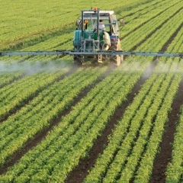
Natural Hydrocarbons and derivates are central to everything today
Benefits and uses of oil & gas – in many demand segments oil & gas have no viable substitutes yet
Power
Fast travel & transport
Medicine
Cooking
Plastic
Fertilizers
Heating
Asphalt
Food additives
Fabrics
Cleaning products
Synthetic rubber
Lubricants
Paints, glues, inks
Cosmetics

Slide 5
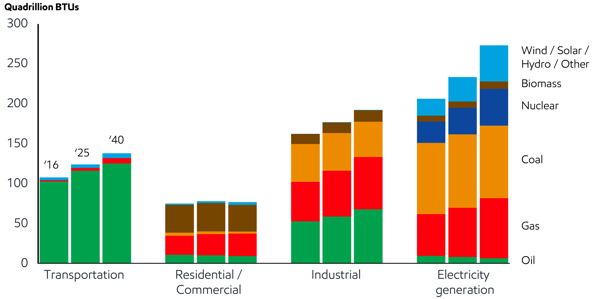
Global energy demand by sector

Slide 6
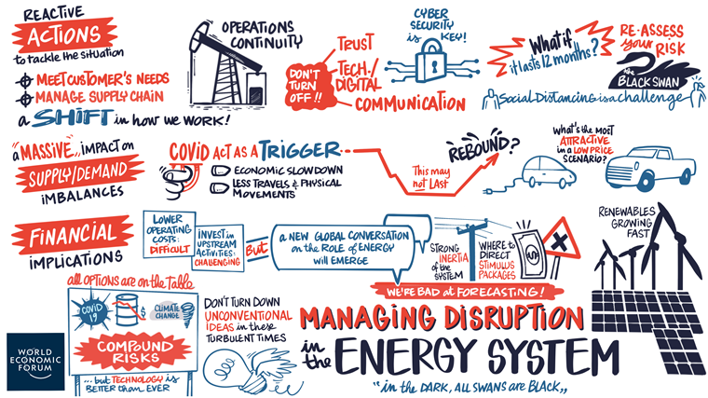
How are our energy systems changing today, and how should we respond?
Source: World Economic Forum, 2020

Slide 7
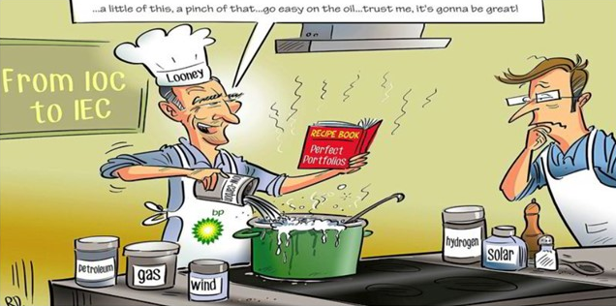
Transitioning from IOC to IEC – the recipe for success?
Recipe for transition success? BP and chief executive Bernard Looney are cooking up something different for the supermajor’s future
Source: Rytis Daukantas / Upstream

